Slide 1
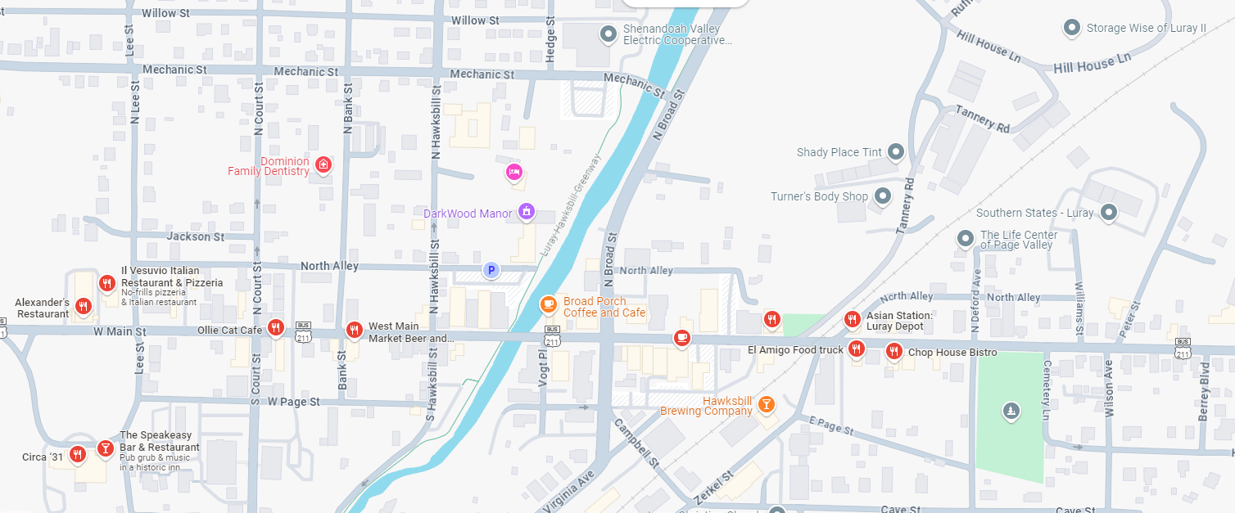
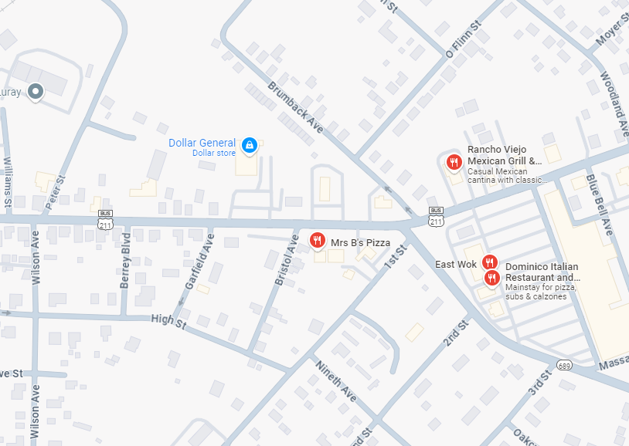
1
2
3
MAIN STREET
Luray Caverns
101 Cave Hill Rd, Luray, VA 22835
4
Continuation of Business 211
Main Street
DCMM Luray Run – Lunch Options
Assembly Point - Parking Lot, 2 Mechanic St, Luray, VA 22835
Vesuvio Italian Restaurant & Pizzeria - 402 W Main St, Luray, VA 22835 (4.3 / 1,408)
Ollie Cat Café - 219 W Main St, Luray, VA 22835 (4.0 / 537)
West Main Market Beer and Wine Garden - 123 W Main St, Luray, VA 22835 (4.6 / 541)
Rancho Viejo Mexican Grill & Cantina - 709 E Main St, Luray, VA 22835 (3.8 / 1,205)
Dominico Italian Restaurant and Pizzeria - 19 E Luray Shopping Ctr, Luray, VA 22835 (4.1 / 487)
5
6
David (703)346-4829

